Slide 1
Blackjack
A consol version

Slide 2
Agenda
Intro
Class diagram
Flowchart
Scoring
Commens (consol interaction)
Demo
Outro

Slide 3
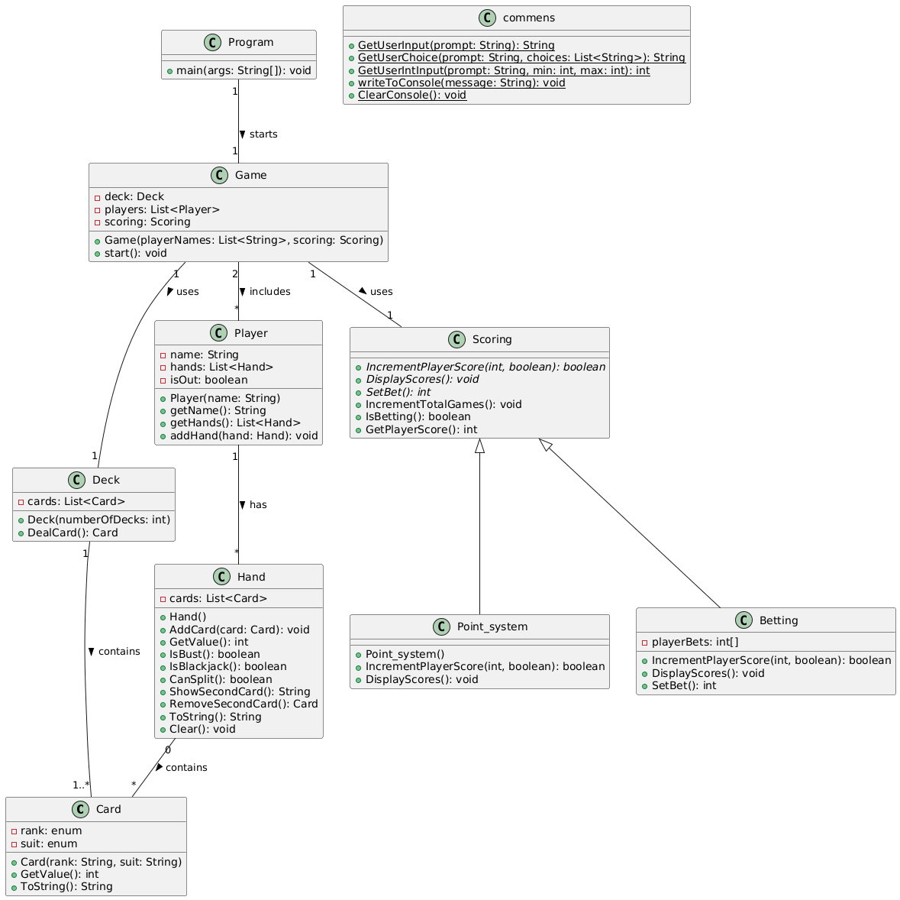

Slide 4
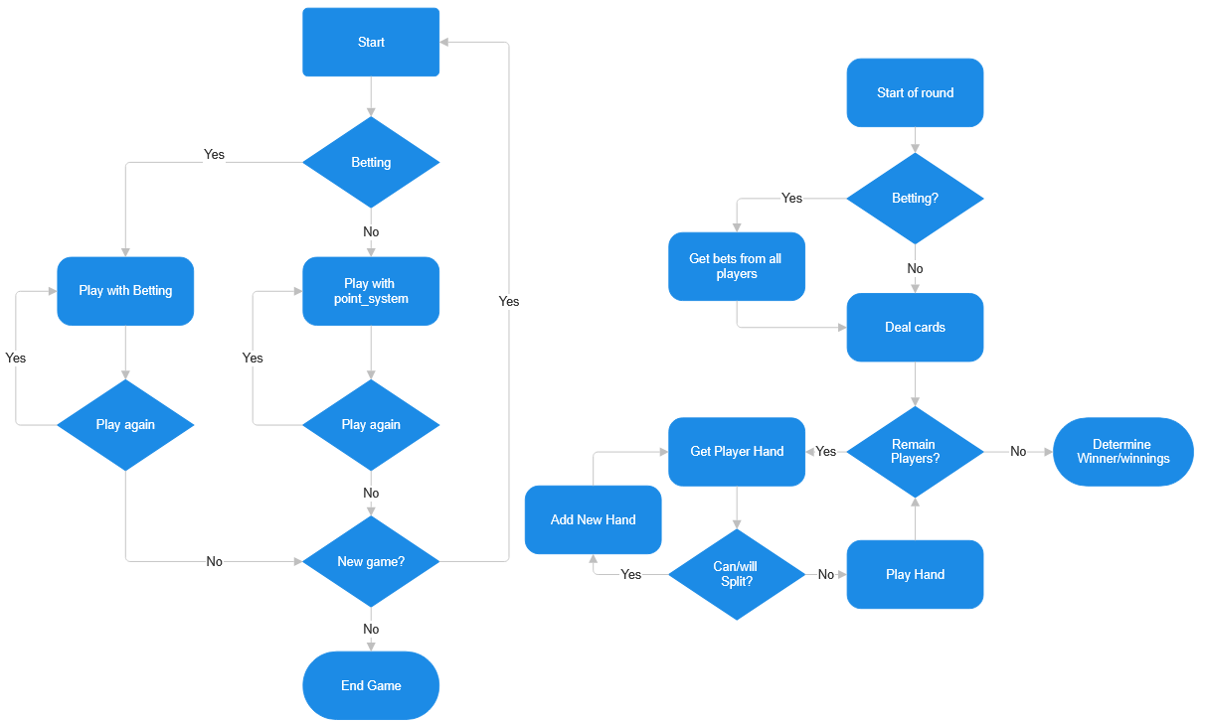

Slide 5
Scoring
Abstract class
Point_system
1 point per win
1 point for the dealer per loss
Betting
Pick starting amount
Keeps track of how much is lost to the dealer

Slide 6
Commens (consol interaction)
Handles all User Interaction
Handles all console display
“Easy” to replace

Slide 7

Demo

Slide 8
End
Thanks for the time ☺

